Slide 1
Chapter 8
Digital Design and Computer Architecture, 2nd Edition
David Money Harris and Sarah L. Harris

Slide 2
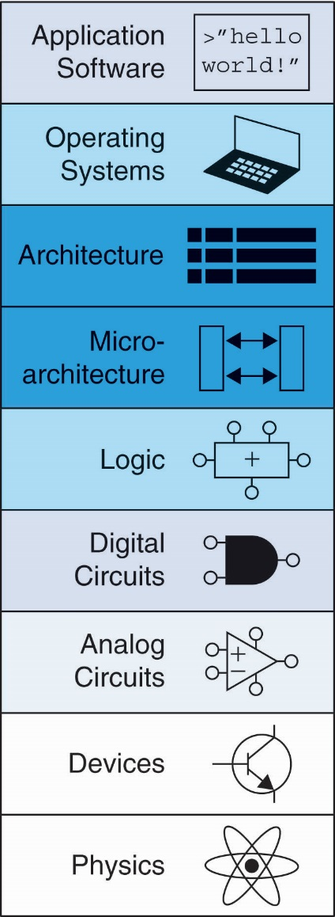
Chapter 8 :: Topics
Introduction
Memory System Performance Analysis
Caches
Virtual Memory
Memory-Mapped I/O
Summary

Slide 3
Introduction
Computer performance depends on:
Processor performance
Memory system performance
Memory Interface

Slide 4
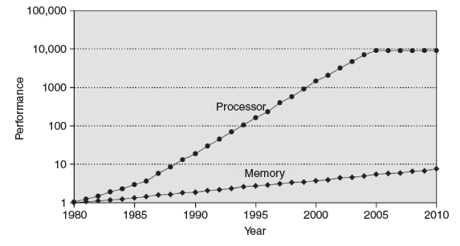
Processor-Memory Gap
In prior chapters, assumed access memory in 1 clock cycle – but hasn’t been true since the 1980’s

Slide 5
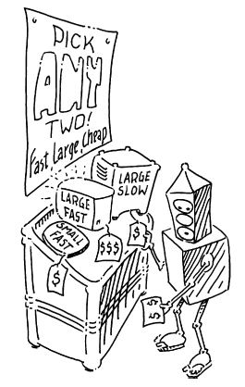
Memory System Challenge
Make memory system appear as fast as processor
Use hierarchy of memories
Ideal memory:
Fast
Cheap (inexpensive)
Large (capacity)
But can only choose two!

Slide 6
Memory Hierarchy

Slide 7
Virtual Memory
Gives the illusion of bigger memory
Main memory (DRAM) acts as cache for hard disk

Slide 8
Memory Hierarchy
Physical Memory: DRAM (Main Memory)
Virtual Memory: Hard drive
Slow, Large, Cheap

Slide 9
Hard Disk
Takes milliseconds to seek correct location on disk

Slide 10
Virtual Memory
Virtual addresses
Programs use virtual addresses
Entire virtual address space stored on a hard drive
Subset of virtual address data in DRAM
CPU translates virtual addresses into physical addresses (DRAM addresses)
Data not in DRAM fetched from hard drive
Memory Protection
Each program has own virtual to physical mapping
Two programs can use same virtual address for different data
Programs don’t need to be aware others are running
One program (or virus) can’t corrupt memory used by another

Slide 11
Cache/Virtual Memory Analogues
Cache | Virtual Memory
Block | Page
Block Size | Page Size
Block Offset | Page Offset
Miss | Page Fault
Tag | Virtual Page Number
Physical memory acts as cache for virtual memory

Slide 12
Virtual Memory Definitions
Page size: amount of memory transferred from hard disk to DRAM at once
Address translation: determining physical address from virtual address
Page table: lookup table used to translate virtual addresses to physical addresses

Slide 13
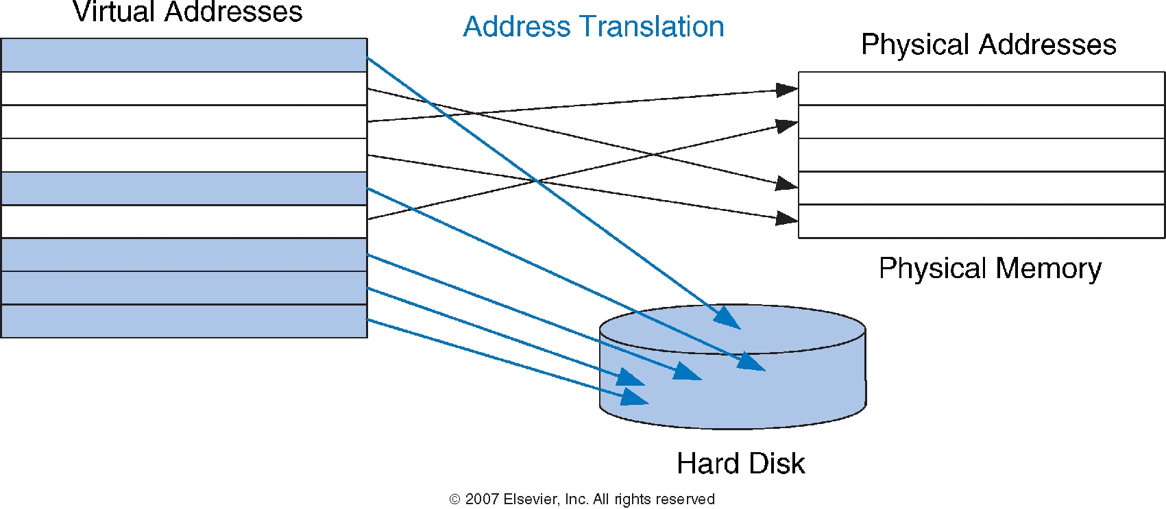
Virtual & Physical Addresses
Most accesses hit in physical memory
But programs have the large capacity of virtual memory

Slide 14
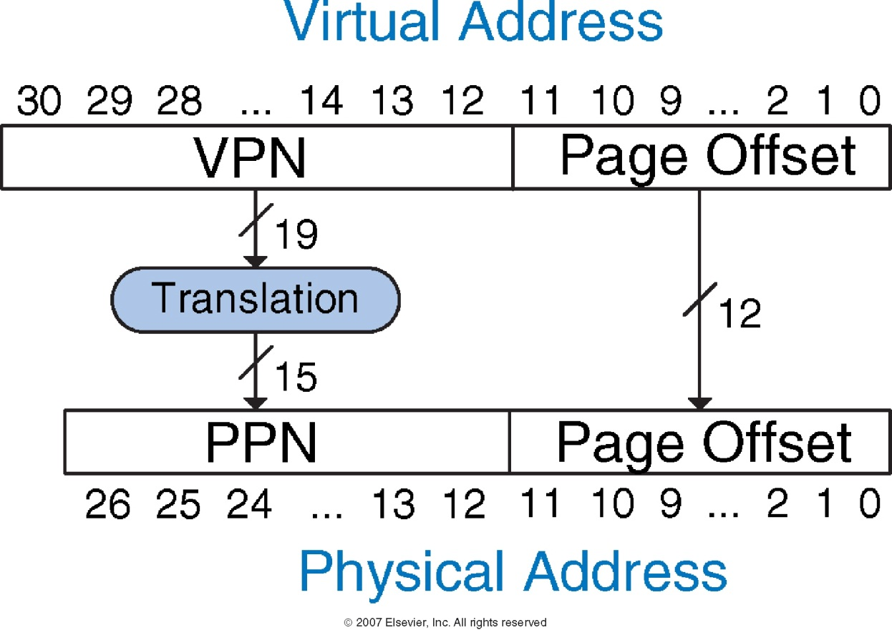
Address Translation

Slide 15
Virtual Memory Example
System:
Virtual memory size: 2 GB = 2³¹ bytes
Physical memory size: 128 MB = 2²⁷ bytes
Page size: 4 KB = 2¹² bytes

Slide 16
Virtual Memory Example
System:
Virtual memory size: 2 GB = 2³¹ bytes
Physical memory size: 128 MB = 2²⁷ bytes
Page size: 4 KB = 2¹² bytes
Organization:
Virtual address: 31 bits
Physical address: 27 bits
Page offset: 12 bits
# Virtual pages = 2³¹/2¹² = 2¹⁹ (VPN = 19 bits)
# Physical pages = 2²⁷/2¹² = 2¹⁵ (PPN = 15 bits)

Slide 17
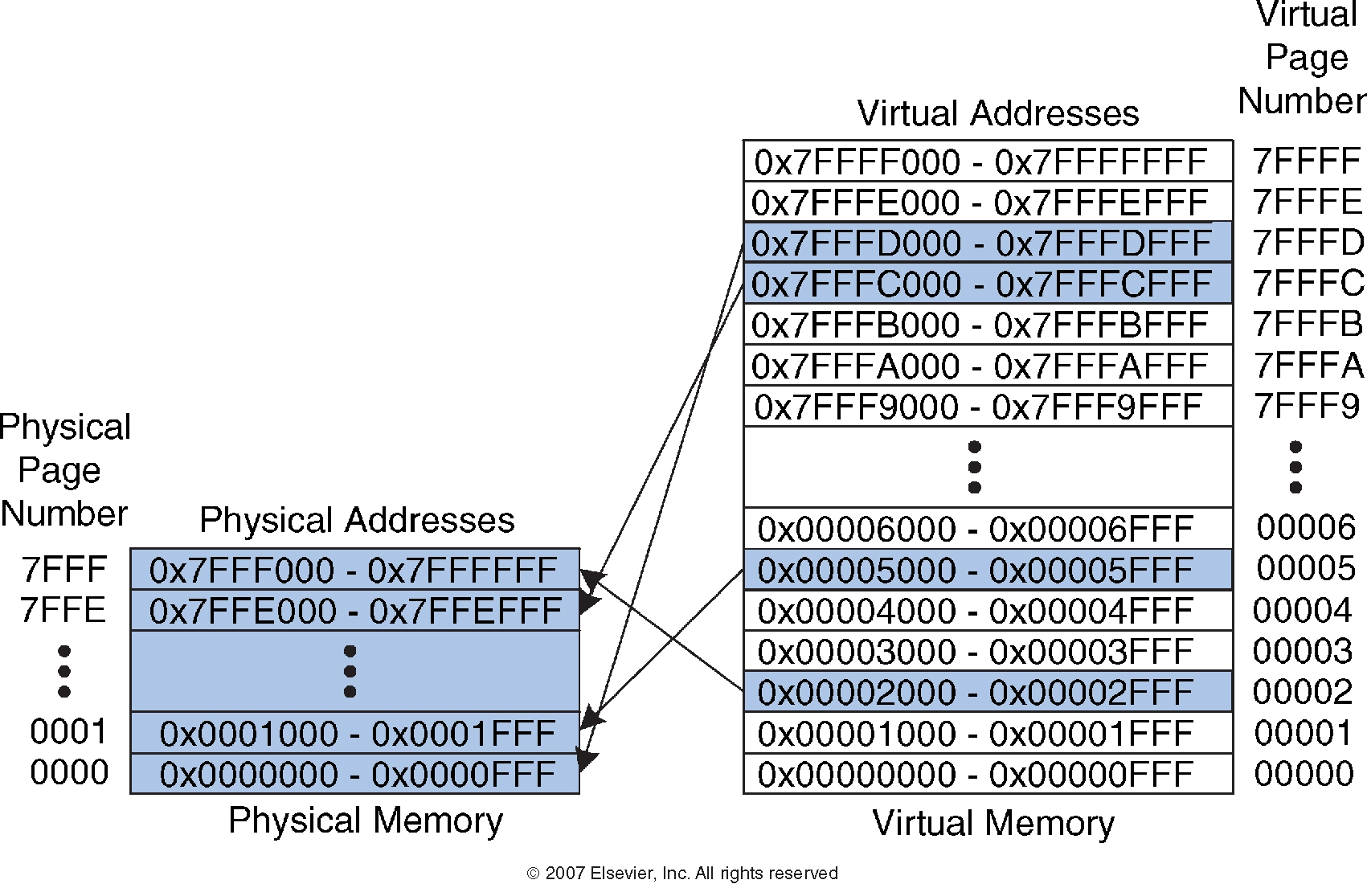
Virtual Memory Example
19-bit virtual page numbers
15-bit physical page numbers

Slide 18
Virtual Memory Example
What is the physical address of virtual address 0x247C?

Slide 19
Virtual Memory Example
What is the physical address of virtual address 0x247C?
VPN = 0x2
VPN 0x2 maps to PPN 0x7FFF
12-bit page offset: 0x47C
Physical address = 0x7FFF47C

Slide 20
How to perform translation?
Page table
Entry for each virtual page
Entry fields:
Valid bit: 1 if page in physical memory
Physical page number: where the page is located

Slide 21
Page Table Example
VPN is index into page table

Slide 22
Page Table Example 1
What is the physical address of virtual address 0x5F20?

Slide 23
Page Table Example 1
What is the physical address of virtual address 0x5F20?
VPN = 5
Entry 5 in page table VPN 5 => physical page 1
Physical address: 0x1F20

Slide 24
Page Table Example 2
What is the physical address of virtual address 0x73E0?

Slide 25
Page Table Example 2
What is the physical address of virtual address 0x73E0?
VPN = 7
Entry 7 is invalid
Virtual page must be paged into physical memory from disk

Slide 26
Page Table Challenges
Page table is large
usually located in physical memory
Load/store requires 2 main memory accesses:
one for translation (page table read)
one to access data (after translation)
Cuts memory performance in half
Unless we get clever…

Slide 27
Translation Lookaside Buffer (TLB)
Small cache of most recent translations
Reduces # of memory accesses for most loads/stores from 2 to 1

Slide 28
TLB
Page table accesses: high temporal locality
Large page size, so consecutive loads/stores likely to access same page
TLB
Small: accessed in < 1 cycle
Typically 16 - 512 entries
Fully associative
> 99 % hit rates typical
Reduces # of memory accesses for most loads/stores from 2 to 1

Slide 29
Example 2-Entry TLB

Slide 30
Memory Protection
Multiple processes (programs) run at once
Each process has its own page table
Each process can use entire virtual address space
A process can only access physical pages mapped in its own page table

Slide 31
Virtual Memory Summary
Virtual memory increases capacity
A subset of virtual pages in physical memory
Page table maps virtual pages to physical pages – address translation
A TLB speeds up address translation
Different page tables for different programs provides memory protection

Slide 32
Memory-Mapped I/O
Processor accesses I/O devices just like memory (like keyboards, monitors, printers)
Each I/O device assigned one or more address
When that address is detected, data read/written to I/O device instead of memory
A portion of the address space dedicated to I/O devices

Slide 33
Memory-Mapped I/O Hardware
Address Decoder:
Looks at address to determine which device/memory communicates with the processor
I/O Registers:
Hold values written to the I/O devices
ReadData Multiplexer:
Selects between memory and I/O devices as source of data sent to the processor

Slide 34
The Memory Interface

Slide 35
Memory-Mapped I/O Hardware

Slide 36
Memory-Mapped I/O Code
Suppose I/O Device 1 is assigned the address 0xFFFFFFF4
Write the value 42 to I/O Device 1
Read value from I/O Device 1 and place in $t3

Slide 37
Memory-Mapped I/O Code
Write the value 42 to I/O Device 1 (0xFFFFFFF4)
addi $t0, $0, 42
sw $t0, 0xFFF4($0)

Slide 38
Memory-Mapped I/O Code
Read the value from I/O Device 1 and place in $t3
lw $t3, 0xFFF4($0)

Slide 39
Input/Output (I/O) Systems
Embedded I/O Systems
Toasters, LEDs, etc.
PC I/O Systems

Slide 40
Embedded I/O Systems
Example microcontroller: PIC32
microcontroller
32-bit MIPS processor
low-level peripherals include:
serial ports
timers
A/D converters

Slide 41
Digital I/O
// C Code
#include <p3xxxx.h>
int main(void) {
int switches;
TRISD = 0xFF00; // RD[7:0] outputs
// RD[11:8] inputs
while (1) {
// read & mask switches, RD[11:8]
switches = (PORTD >> 8) & 0xF;
PORTD = switches; // display on LEDs
}
}

Slide 42
Serial I/O
Example serial protocols
SPI: Serial Peripheral Interface
UART: Universal Asynchronous Receiver/Transmitter
Also: I²C, USB, Ethernet, etc.

Slide 43
SPI: Serial Peripheral Interface
Master initiates communication to slave by sending pulses on SCK
Master sends SDO (Serial Data Out) to slave, msb first
Slave may send data (SDI) to master, msb first

Slide 44
UART: Universal Asynchronous Rx/Tx
Configuration:
start bit (0), 7-8 data bits, parity bit (optional), 1+ stop bits (1)
data rate: 300, 1200, 2400, 9600, …115200 baud
Line idles HIGH (1)
Common configuration:
8 data bits, no parity, 1 stop bit, 9600 baud

Slide 45
Timers
// Create specified ms/us of delay using built-in timer
#include <P32xxxx.h>
void delaymicros(int micros) {
if (micros > 1000) { // avoid timer overflow
delaymicros(1000);
delaymicros(micros-1000);
}
else if (micros > 6){
TMR1 = 0; // reset timer to 0
T1CONbits.ON = 1; // turn timer on
PR1 = (micros-6)*20; // 20 clocks per microsecond
// Function has overhead of ~6 us
IFS0bits.T1IF = 0; // clear overflow flag
while (!IFS0bits.T1IF); // wait until overflow flag set
}
}
void delaymillis(int millis) { while (millis--) delaymicros(1000); // repeatedly delay 1 ms
} // until done

Slide 46
Analog I/O
Needed to interface with outside world
Analog input: Analog-to-digital (A/D) conversion
Often included in microcontroller
N-bit: converts analog input from V_{ref-}-V_{ref+} to 0-2^{N-1}
Analog output:
Digital-to-analog (D/A) conversion
Typically need external chip (e.g., AD558 or LTC1257)
N-bit: converts digital signal from 0-2^{N-1} to V_{ref-}-V_{ref+}
Pulse-width modulation

Slide 47
Pulse-Width Modulation (PWM)
Average value proportional to duty cycle
Add high-pass filter on output to deliver average value

Slide 48
Other Microcontroller Peripherals
Examples
Character LCD
VGA monitor
Bluetooth wireless
Motors

Slide 49
Personal Computer (PC) I/O Systems
USB: Universal Serial Bus
USB 1.0 released in 1996
standardized cables/software for peripherals
PCI/PCIe: Peripheral Component Interconnect/PCI Express
developed by Intel, widespread around 1994
32-bit parallel bus
used for expansion cards (i.e., sound cards, video cards, etc.)
DDR: double-data rate memory

Slide 50
Personal Computer (PC) I/O Systems
TCP/IP: Transmission Control Protocol and Internet Protocol
physical connection: Ethernet cable or Wi-Fi
SATA: hard drive interface
Input/Output (sensors, actuators, microcontrollers, etc.)
Data Acquisition Systems (DAQs)
USB Links

